Slide 1
Project 3
Most Streamed Songs Spotify 2023
Our Music Playlists
Search
Home
Library
By: Nikki Alfrey, Andrew Bollinger, Ling Bramlett

Slide 2
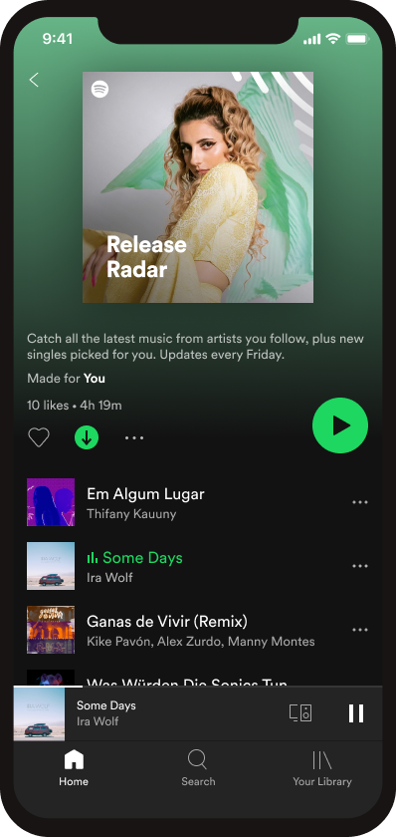
Project 3 Most Streamed Songs on Spotify 2023
Our dataset was retrieved from Kaggle from a user named Nidula E.
Key data points considered:
953 total songs
489B total streams for all songs
Songs released from 1930-2023 were streamed
1930 song was considered an error in the dataset
29 were holiday songs
What song do you think was the number 1 streamed song in 2023?

Slide 3

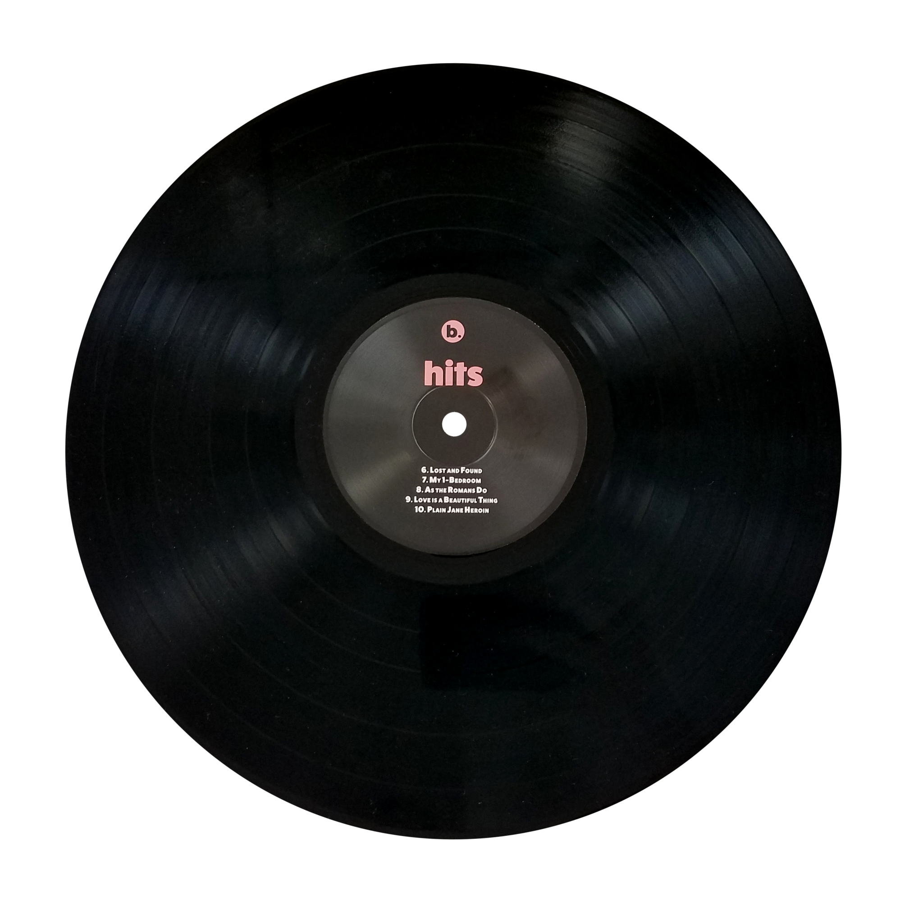
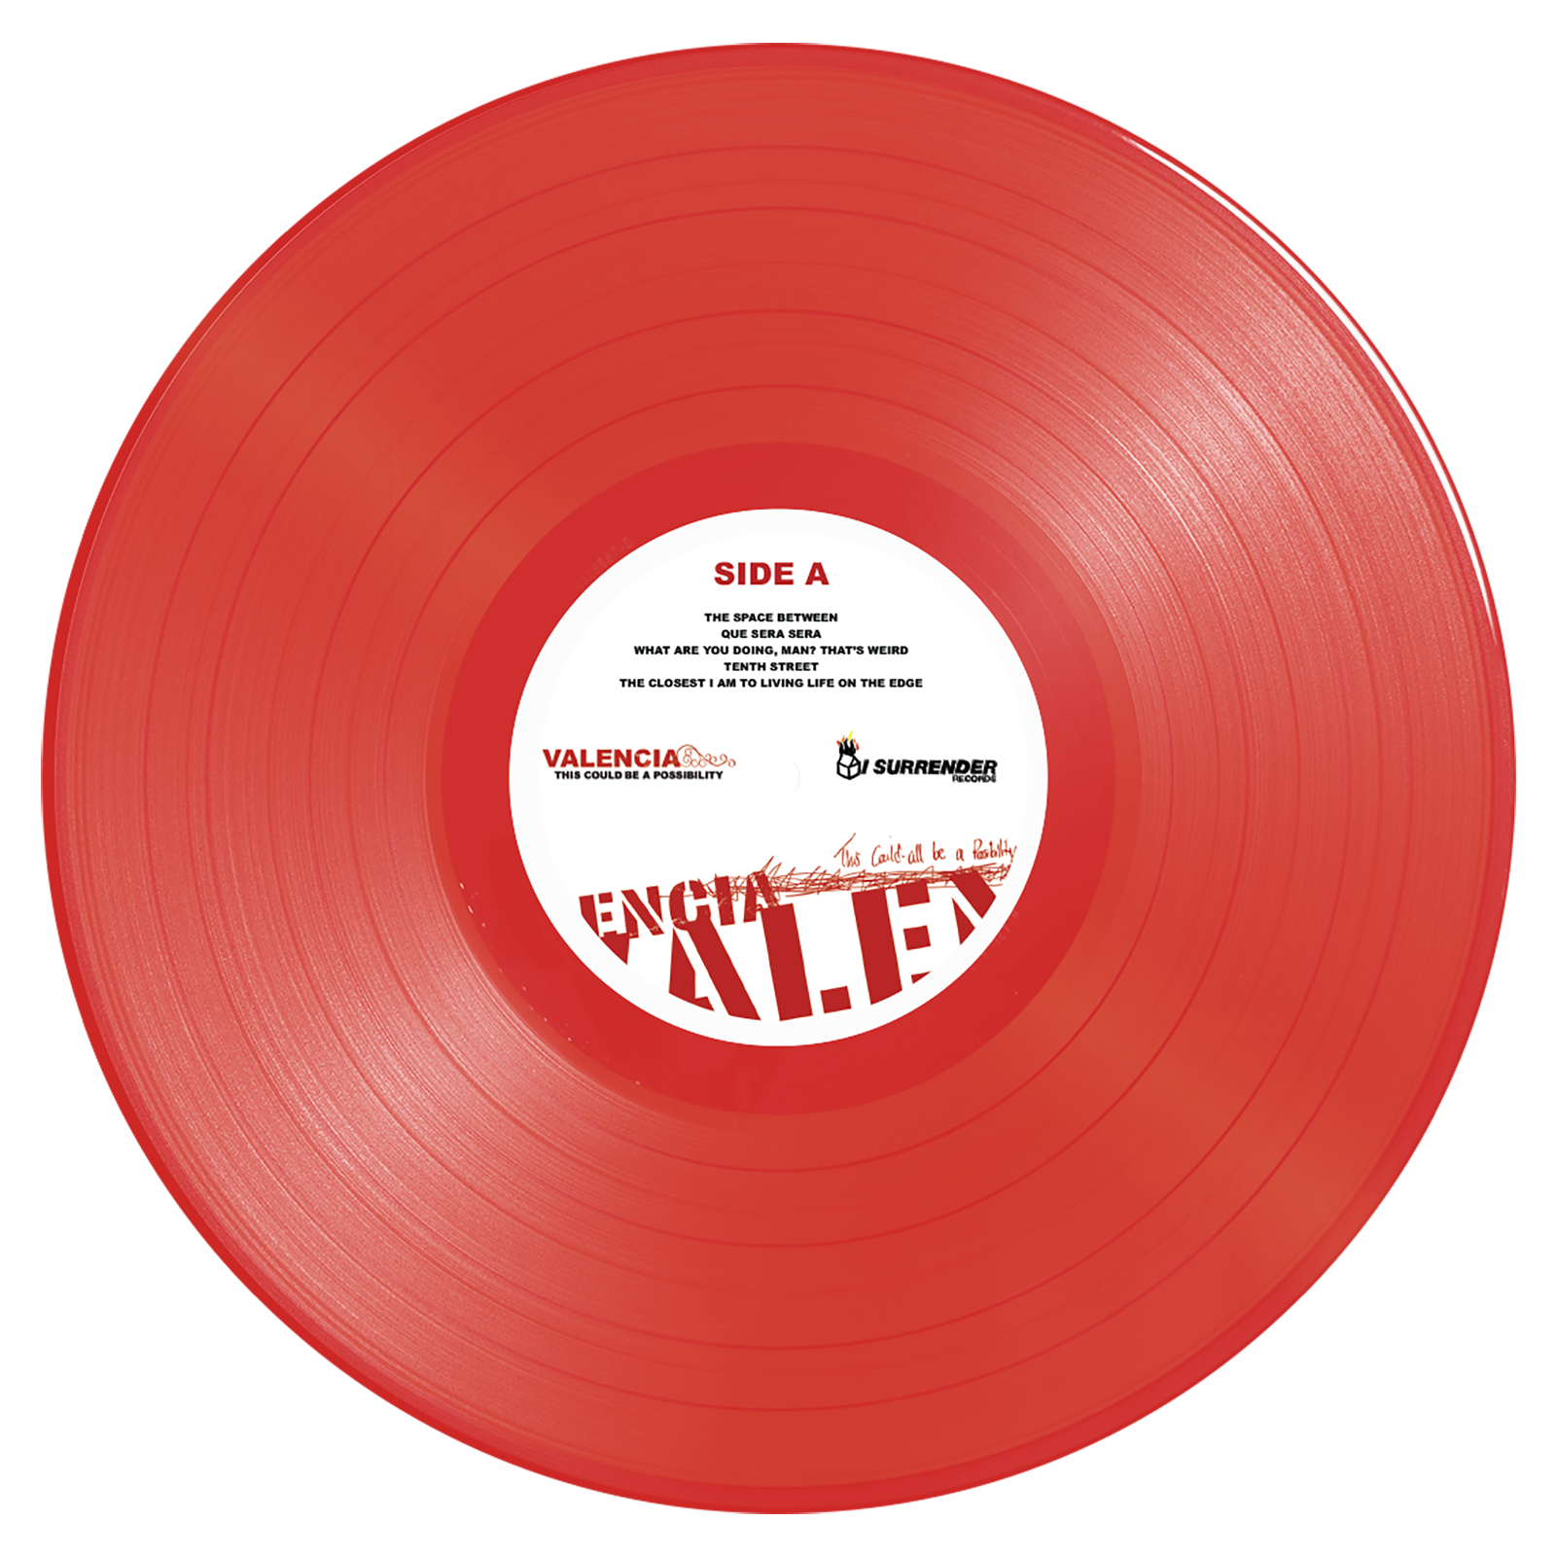
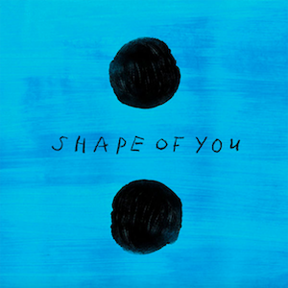

Top Three Songs and Artist(s)

Slide 4

2023 Top 10 Songs by Number of Streams
Interesting fact(s):
Top 10 all had over 2.56B streams
5.7% of the total song streams
Released years 2016-2021

Slide 5
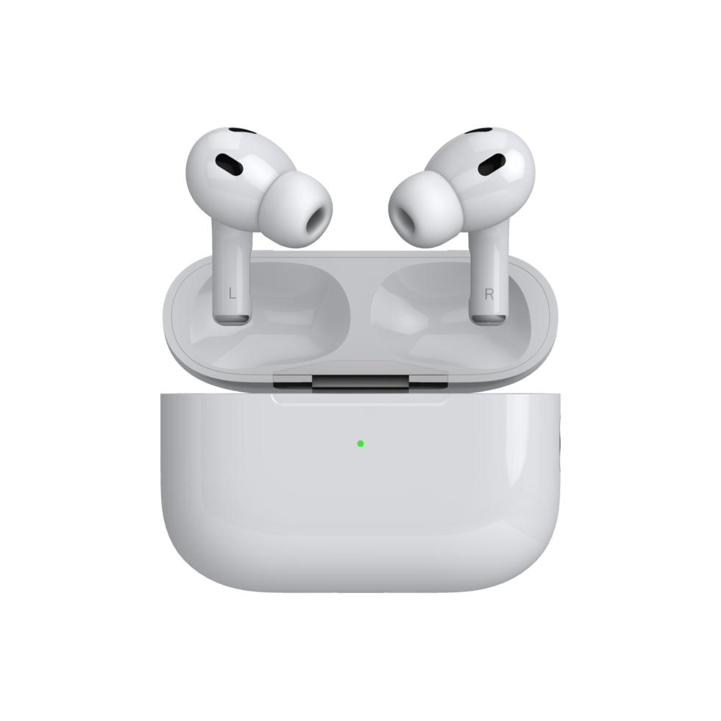
2023 Top Streams by Release Year
Interesting facts:
Songs ranged from 1942 through 2023
402 of the 953 songs were released in 2022
904 were released after 2000

Slide 6
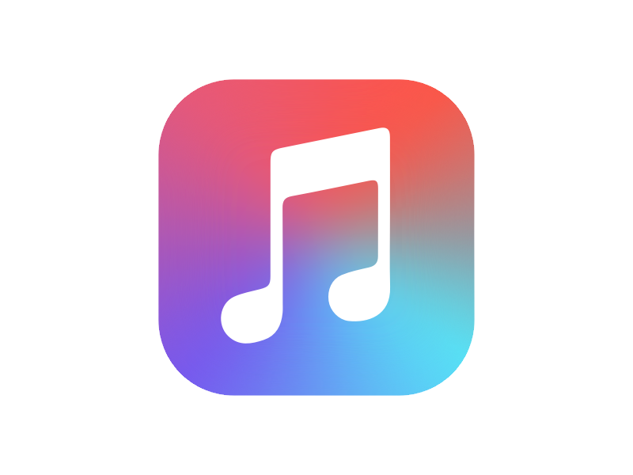

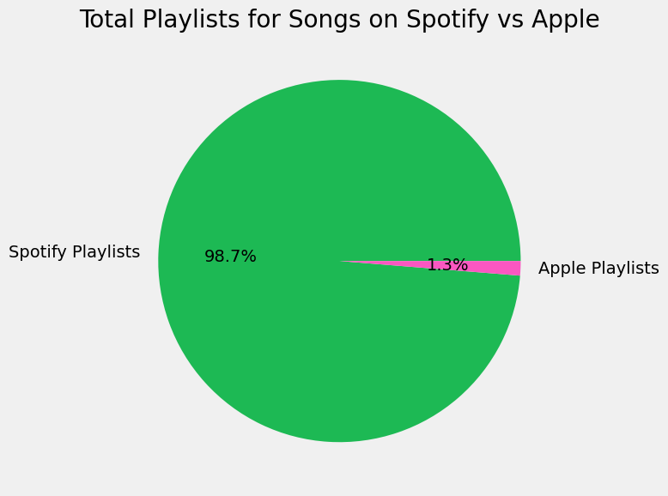
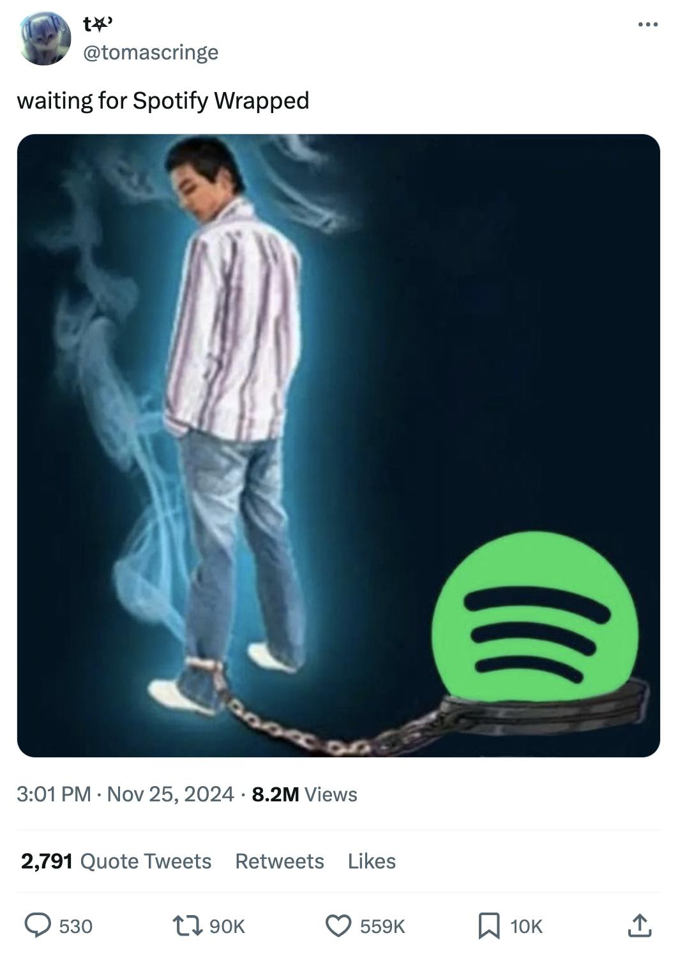
Spotify vs Apple Playlist
Interesting fact(s):
Of the 953 songs, these song were included in 4.95M Spotify playlists, but only in 64k Apple playlist

Slide 7
User Interaction - Is your favorite artist on the list?
How to use:
Enter the artist name: _________
See the track(s) that were popular in 2023: __________

Slide 8



2023 Spotify Wrapped
1.3%
Top 3 artists
Your favorite song was…
The Weekend
You streamed it 3.70 Billion times
Favorite song: Blinding Lights
98.7%
Ed Sheeran
Blinding Lights
Spotify
You streamed it 3.56 Billion times
by The Weekend
Favorite song: Shape of You
Fan Favorite
Lewis Capaldi
You listened to it
Apple
3.70 B
Niche Audience
You streamed it 2.88 Billion times
Favorite song: Someone you Love
times. You must really liked it!

Slide 9

That’s a Wrap!
Search
Home
Library

